Slide 1
AutoChoice
Adriano Vale Ary Farah Ícaro Kuchanovicz Mariana Sprada Vinicius Dorneles

Slide 2
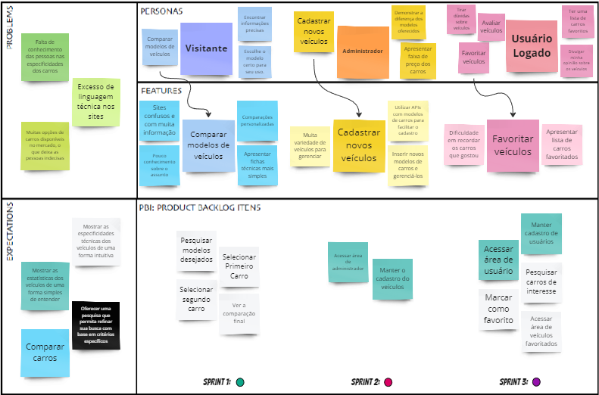
Canvas PBB

Slide 3
Personas / Features

Slide 4
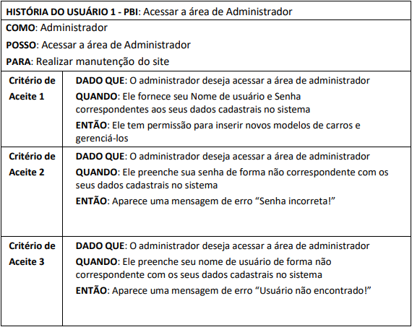
PBIs

Slide 5
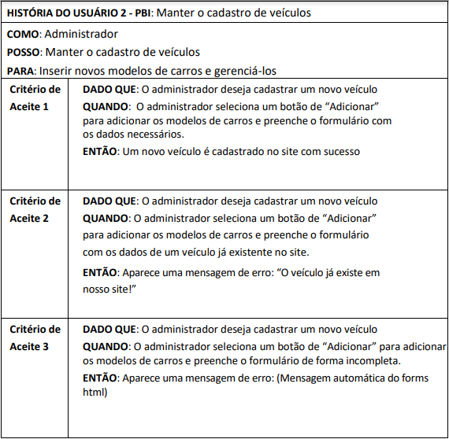
User Stories

Slide 6
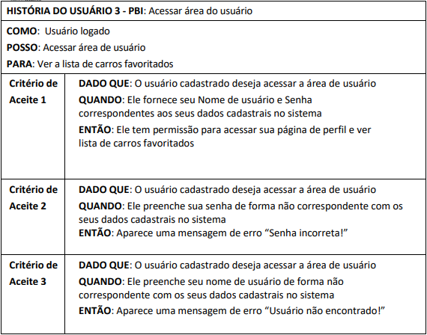
User Stories

Slide 7
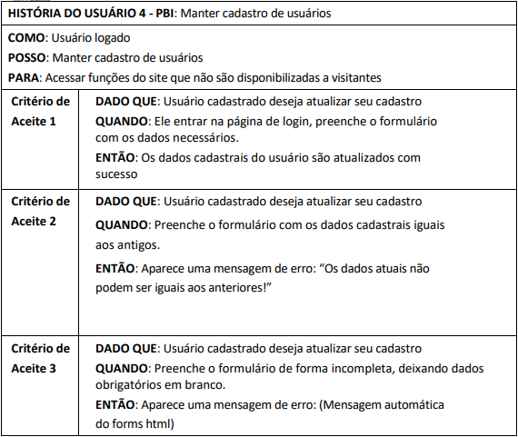
User Stories

Slide 8
User Stories

Slide 9
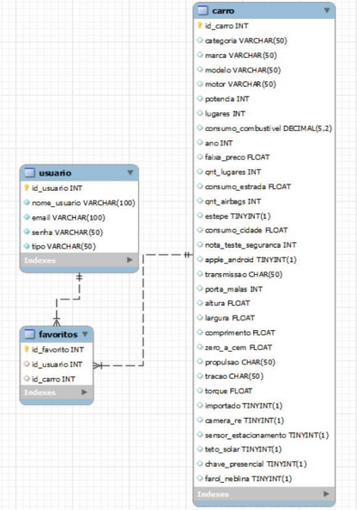
Modelo Relacional

Slide 10

Implementação

